Slide 1
Sentiment Analysis on Hotel Reviews Using Machine Learning Techniques
Frontier Tech Leaders Programme Global Cohort 1
Anas ALHARDI
Taha Mohammadyar
December 2023

Slide 2
Outline
Frontier Tech Leaders Programme Global Cohort 1
Concept note and implementation plan:
Background
Objectives
SDG Relation
Data
Data Collection
Exploratory Data Analysis (EDA) and Feature Engineering
Model Selection and Training
Model Evaluation and Hyperparameter Tuning
Model Refinement and Testing
Results
Deployment
Future Work

Slide 3
Concept note and implementation plan
Frontier Tech Leaders Programme Global Cohort 1

Slide 4
Background
Frontier Tech Leaders Programme Global Cohort 1
Project Overview: Analyzing sentiments in hospitality through machine learning for efficient processing of online hotel reviews.
Background: Manual review analysis is inefficient due to the overwhelming volume of online feedback. Our solution leverages machine learning to automate sentiment classification.
Importance: Critical for the hospitality industry, our project addresses the need for scalable and automated sentiment analysis, providing businesses with valuable insights for continuous improvement.

Slide 5
Objectives
Frontier Tech Leaders Programme Global Cohort 1
Our project aims to achieve the following:
Develop a machine learning model for sentiment analysis on hotel reviews.
Classify reviews into positive, negative, or neutral categories.
Compare the performance of different machine learning algorithms.
By achieving these objectives, our project contributes to addressing the challenge of efficiently processing and understanding customer sentiments in the hospitality industry, ultimately supporting businesses in improving their services and making data driven decisions.

Slide 6

SDG Relation
Frontier Tech Leaders Programme Global Cohort 1
This project aligns with SDG 8, which promotes decent work and economic growth. By automating the analysis of hotel reviews, businesses can gain valuable insights into customer sentiment, allowing them to make informed decisions that improve customer satisfaction, attract more guests, and ultimately boost their economic growth

Slide 7
Data
Frontier Tech Leaders Programme Global Cohort 1

Slide 8
Data Collection
Frontier Tech Leaders Programme Global Cohort 1
Data Source:
Sourced from Kaggle, our TripAdvisor Hotel Reviews dataset comprises 20,491 English reviews. With "Review" for textual feedback and "Rating" for star ratings, this structured data streamlines efficient analysis, facilitating insightful extraction.
Variable | Explanation
Data Source | Hotel reviews dataset from TripAdvisor website
Data Size | 20,491 hotel reviews
Variables | Review | Written text of the review
 | Rating | Rating of the hotel from 1 to 5 stars

Slide 9
Data Collection
Frontier Tech Leaders Programme Global Cohort 1
Preprocessing steps: Prior to data analysis, a data cleansing process was performed including:
Converting text to lowercase.
Removal of non-numeric characters and symbols.
Remove stop words (like “and,” “for,” “with”).
Transforming words into their roots by applying the word stemming process (Lemmatization).

Slide 10
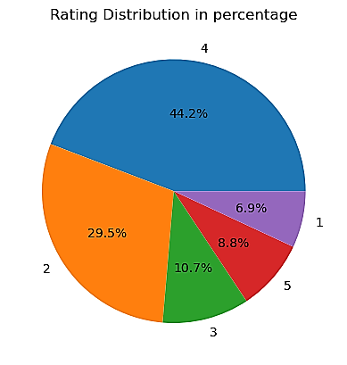
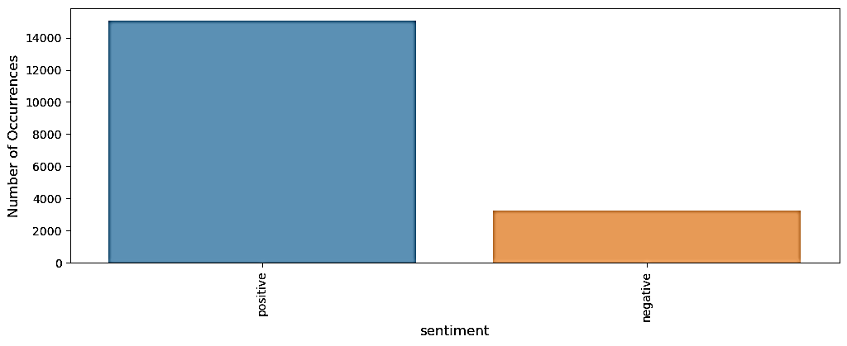
Exploratory Data Analysis (EDA)
Frontier Tech Leaders Programme Global Cohort 1
TripAdvisor hotel reviews dataset generally indicates a dominance of 5 and 4 ratings, reflecting predominantly positive sentiments. When examining the data, it can be observed that the combined ratings of 5 and 4 constitute more than 70% of the total evaluations.
Hotel reviews are classified as positive if the hotel has a rating of 3 stars or higher, and negative if it has a rating of 2 stars or lower.

Slide 11
Feature Engineering
Frontier Tech Leaders Programme Global Cohort 1
Created a new feature, 'clean_text,' through a multi-step process, including text cleaning, case conversion, stop-word removal, stemming, and lemmatization.
Introduced the 'Sentiment' feature, categorizing reviews into positive (5, 4) and negative (1, 2, 3) sentiments based on ratings.
 | clean_word | Rating
0 | nice hotel expens park got good deal stay hote... | 4
1 | ok noth special charg diamond member hilton de. | 2
2 | nice room experi hotel monaco seattl good hote... | 3
3 | uniqu great stay wonder time hotel monaco loca.. | 5
4 | great stay great stay went seahawk game awesom | 5
…. | ok just looks nice modern outside, desk staff ... | 2
 | clean_word | Rating | sentiment
0 | nice hotel expens park got good deal stay hote... | 4 | 1
1 | ok noth special charg diamond member hilton… | 2 | 0
2 | nice room experi hotel monaco seattl good hote.. | 3 | 1
3 | uniqu great stay wonder time hotel monaco loca. | 5 | 1
….. | …… | … | …
20490 | great stay great stay went seahawk game … | 5 | 1

Slide 12
Model
Frontier Tech Leaders Programme Global Cohort 1

Slide 13
Model Selection and Training
Frontier Tech Leaders Programme Global Cohort 1
Rationale for choosing a specific model:
Decision Tree Classifier was chosen for sentiment analysis on hotel reviews. Decision trees are suitable for classification tasks, and their interpretability makes them useful for understanding feature importance.
Logistic Regression was selected for its simplicity and effectiveness in binary classification problems, making it a good baseline model.
Naive Bayes Classifier was included due to its efficiency, simplicity, and effectiveness in text classification tasks

Slide 14
Model Selection and Training
Frontier Tech Leaders Programme Global Cohort 1
The strengths and weaknesses:
Decision Tree, Logistic Regression, Naive Bayes.
Model | Strengths | Weaknesses
Decision Tree | Handles non-linear relationships. | Prone to overfitting.
Decision Tree | Easy to interpret. | Sensitive to small variations in the data.
Logistic Regression | Simple and interpretable. | Assumes a linear relationship between features and the log-odds of the response.
Logistic Regression | Works well for linearly separable data.
Naive Bayes | Efficient, works well with high-dimensional data. | Assumes independence between features.
Naive Bayes | Handles missing data and imbalanced datasets. | Assumes independence between features.

Slide 15
Model Selection and Training
Frontier Tech Leaders Programme Global Cohort 1
Comparison of Models
Feature | Decision Tree | Logistic Regression | Naive Bayes
Accuracy | Moderate | Moderate | Moderate
Overfitting | High | Low | Low
Interpretability | High | High | High
Data preprocessing | Low | Moderate | Low
Computational cost | Low | Low | Low
Non-linear relationships | Yes | No | No

Slide 16
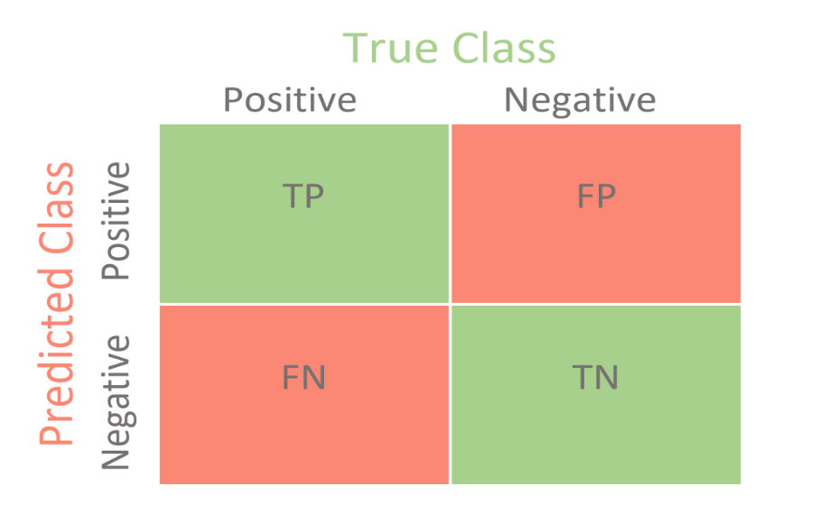
Model Evaluation and Hyperparameter Tuning
Frontier Tech Leaders Programme Global Cohort 1
 | Precision | Recall | F1-score | Support
positive
negative
Accuracy
Macro ang
Weighted avg
Evaluation metrics and visualizations
Evaluation Metrics:
Accuracy, Precision, Recall, and F1 Score.
Visualizations:
Confusion Matrix.

Slide 17
Models Performance
Frontier Tech Leaders Programme Global Cohort 1
Model's Performance Overview
Decision Tree:
Testing Accuracy: 0.775
Precision, Recall, and F1 Score metrics.
Logistic Regression:
Testing Accuracy: 0.8871
Precision, Recall, and F1 Score metrics.
Naive Bayes:
Testing Accuracy: 0.6279
Precision, Recall, and F1 Score metrics.

Slide 18
Model Evaluation and Hyperparameter Tuning
Frontier Tech Leaders Programme Global Cohort 1
Details on Hyperparameter Tuning
Decision Tree:
Default hyperparameters; no significant tuning impact.
Logistic Regression:
Tuned learning rates and regularization parameters.
Impact on accuracy and convergence speed.
Cross-Validation:
Demonstrated impact on generalization.

Slide 19
Model Refinement Overview
Frontier Tech Leaders Programme Global Cohort 1
Refinement Phase Highlights :
Objective:
Enhance initial model performance iteratively.
Challenges Addressed:
Overfitting, precision, and recall improvements.

Slide 20
Techniques for Model Improvement
Frontier Tech Leaders Programme Global Cohort 1
Refinement Techniques
Alternative Algorithms:
Random Forest and Support Vector Machines (SVM).
Ensemble Methods:
Voting Classifier combining various models.
Hyperparameter Tuning:
Learning rates, regularization, batch sizes.
Cross-Validation:
Adjusted folds and applied stratified sampling.

Slide 21
Techniques for Model Improvement
Frontier Tech Leaders Programme Global Cohort 1
we employed Random Forest and Support Vector Machines (SVM) to enhance model performance.
Random Forest
Improved accuracy over a single decision tree.
Support Vector Machines (SVM)
Effective in high-dimensional spaces.
Versatile with different kernel functions.
Robust to overfitting.

Slide 22
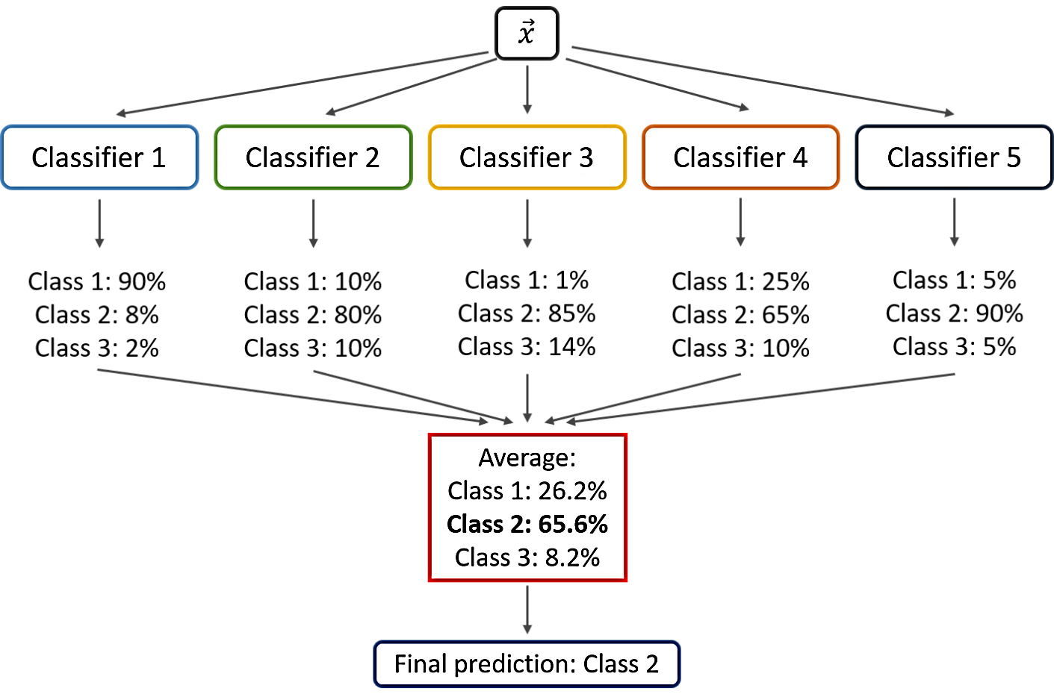
Techniques for Model Improvement
Frontier Tech Leaders Programme Global Cohort 1
VotingClassifier:
VotingClassifier is an algorithm that enhances classification accuracy by combining multiple classifiers. It has the potential to achieve high accuracy rates on both training and testing data.

Slide 23
Test Submission Overview
Frontier Tech Leaders Programme Global Cohort 1
Test Submission Phase
Dataset Preparation:
Same preprocessing as training and validation datasets.
Model Application:
Applied the trained model to a distinct test dataset.
Metrics and Results:
Calculated accuracy, precision, recall, and F1 Score.

Slide 24
Metrics and Results on Test Dataset
Frontier Tech Leaders Programme Global Cohort 1
Test Dataset Performance
Metrics:
Accuracy, Precision, Recall, F1 Score.
Comparison:
Evaluate consistency with training and validation metrics.
Highlight Key Findings:
How well the model generalizes to novel, unseen data.

Slide 25
Results
Frontier Tech Leaders Programme Global Cohort 1

Slide 26
Results
Frontier Tech Leaders Programme Global Cohort 1
In our project, we found that TripAdvisor hotel reviews are mostly positive (86.74%) and a small portion of them are negative (13.26%). These reviews show that TripAdvisor services accurately reflect user satisfaction.

Slide 27
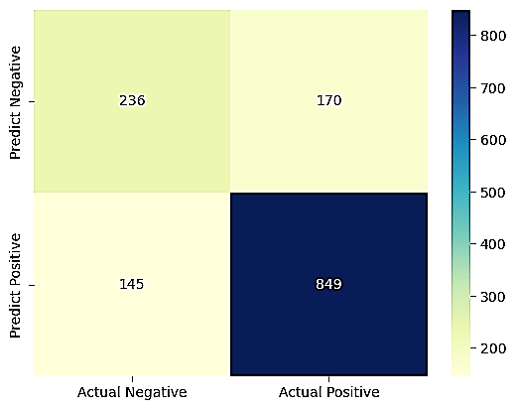
Evaluation Results
Frontier Tech Leaders Programme Global Cohort 1
Decision Tree:
In training, the model achieved perfect accuracy (1.0). However, its performance dropped to 0.775 on the test data, indicating oerfitting.
 | Precision | Recall | F1-score | Support
positive | 0.62 | 0.58 | 0.60 | 406
negative | 0.83 | 0.85 | 0.84 | 994
Accuracy |  |  | 0.78 | 1400
Macro ang | 0.73 | 0.72 | 0.72 | 1400
Weighted avg | 0.77 | 0.78 | 0.77 | 1400

Slide 28
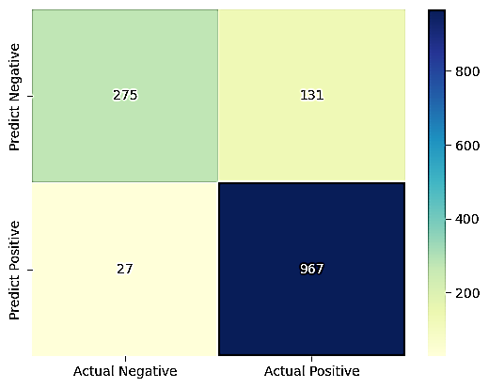
Evaluation Results
Frontier Tech Leaders Programme Global Cohort 1
Logistic Regression:
The accuracy score in training is 0.9268, which means that the model has a good fit to the training data. In the test, it is 0.8871, which means that the model is also successful in the test data.
 | Precision | Recall | F1-score | Support
positive | 0.91 | 0.68 | 0.78 | 406
negative | 0.88 | 0.97 | 0.92 | 994
Accuracy |  |  | 0.89 | 1400
Macro ang | 0.90 | 0.83 | 0.85 | 1400
Weighted avg | 0.89 | 0.89 | 0.88 | 1400

Slide 29
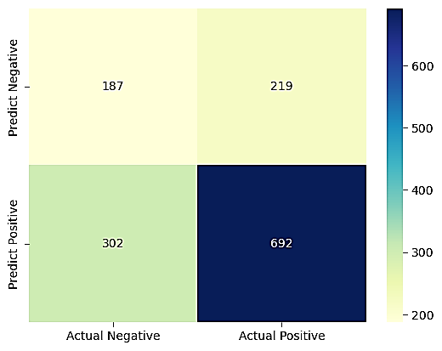
Evaluation Results
Frontier Tech Leaders Programme Global Cohort 1
Naive Bayes:
The training accuracy is 86.45%, which means that the model successfully fit the training data. However, the test accuracy is 62.79%, which indicates that the model performs worse on the test data.
 | Precision | Recall | F1-score | Support
positive | 0.38 | 0.46 | 0.42 | 406
negative | 0.76 | 0.70 | 0.73 | 994
Accuracy |  |  | 0.89 | 1400
Macro ang | 0.57 | 0.58 | 0.57 | 1400
Weighted avg | 0.65 | 0.63 | 0.64 | 1400

Slide 30
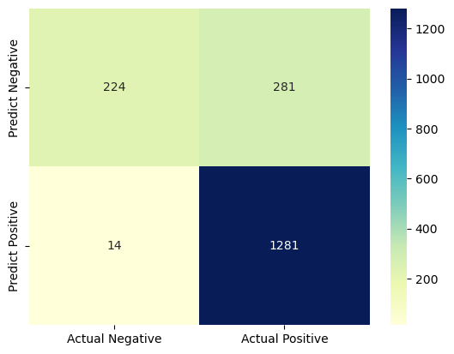
Evaluation Results
Frontier Tech Leaders Programme Global Cohort 1
Random Forest:
Despite a perfect training accuracy of 1.0, the model's performance drops to 0.8361 on test data, suggesting overfitting and highlighting the need for further optimization to ensure better generalization.
 | Precision | Recall | F1-score | Support
positive | 0.94 | 0.44 | 0.60 | 505
negative | 0.82 | 0.99 | 0.90 | 1295
Accuracy |  |  | 0.84 | 1800
Macro ang | 0.88 | 0.72 | 0.75 | 1800
Weighted avg | 0.85 | 0.84 | 0.81 | 1800

Slide 31
Evaluation Results
Frontier Tech Leaders Programme Global Cohort 1
Support Vector Machine (SVM):
Remarkable results were achieved with a training accuracy score of 0.9869 and a testing accuracy score of 0.8939 for the Support Vector Machine (SVM) algorithm.
Despite the impressive performance, this algorithm was excluded due to its excessively time-consuming training and testing processes, rendering it impractical for real-time application environments.

Slide 32
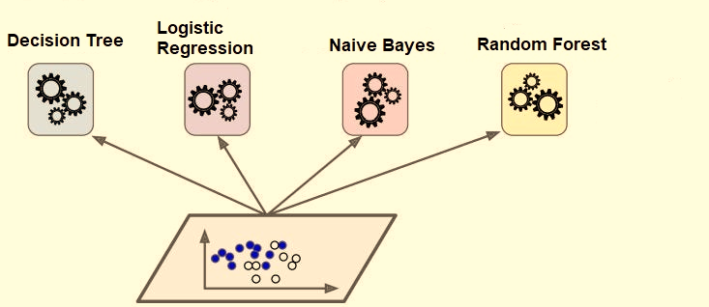
Evaluation Results
Frontier Tech Leaders Programme Global Cohort 1
Voting Classifier:
The model exhibits excellent learning from the training data, achieving a high accuracy score of 99.85%. Although the testing accuracy is slightly lower at 86.11%, the overall performance is still robust, indicating the model's capability to generalize well to unseen data. Further optimization and evaluation may enhance its effectiveness in real-world scenarios.

Slide 33
Comparison of results
Frontier Tech Leaders Programme Global Cohort 1
The results will be compared with the following table, which shows the difference between the training accuracy and test accuracy of each classification algorithm.
Algorithm | Training Accuracy | Testing Accuracy
Decision Tree | 1.0 | 0.765
Logistic Regression | 0.9306 | 0.8889
Naive Bayes | 0.8333 | 0.6094
Random Forest | 1.0 | 0.8361
Voting Classifier | 0.9985 | 0.8611

Slide 34
Deployment
Frontier Tech Leaders Programme Global Cohort 1
Overview of the deployment phase
Model serialization, serving, and API integration
(You can fill this part after deployment submission)

Slide 35
Future Work
Frontier Tech Leaders Programme Global Cohort 1
To deepen our understanding of sentiment analysis, we aim to leverage various datasets, focusing on analyzing insights and emotions related to specific products. One avenue we are exploring involves extracting and analyzing a curated set of tweets from platforms like Twitter, gauging people's opinions and reactions towards issues, whether they be political, social, or emerging technological trends. We believe the abundance of data available in this realm presents an opportunity for comprehensive analysis. Our emphasis lies not just in organizing this data but also harnessing its value, providing accurate and meaningful insights.

Slide 36


Thank you!
Frontier Tech Leaders Programme Global Cohort 1

